Slide 1
Introduction to Gene Expression- I
Mridula Nandakumar [Mri-du-la]
Doctoral student, Department of Biology,
Lund University, Sweden
mridula.nandakumar@biol.lu.se
Computer Science in Modern Biology Workshop
31.07.2023

Slide 2
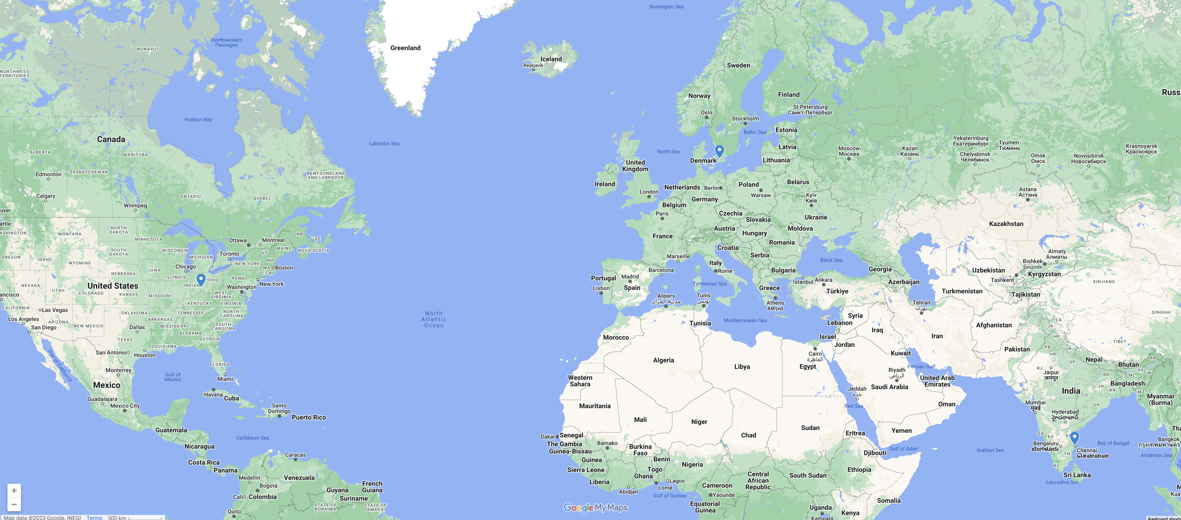

Slide 3
Learning outcomes
Broad overview of transciptome sequencing and analysis
Understand the basics of next-generation sequencing for RNA
Understand rationale behind every step in a standard RNA-seq pipeline
Some coding
Familiarity with working in a linux-based environment and R
Understand what is being done
Data analysis
Understand and interpret plots associated with RNA-seq analysis
How to find biological meaning in the data

Slide 4
Workshop overview
1st day
Introduction to transcriptome sequencing
Execute pipeline for transcriptome analysis with 1 sample: download data, quality control, index and map reads
Primarily in terminal (shell based)
Installations of required programs
2nd day
Introduction to data analyses commonly used in RNA-seq
Analysis of differential gene expression using Deseq2
Interpretation of different plots and tools for DGE
Primarily in R
Installation of required R packages

Slide 5
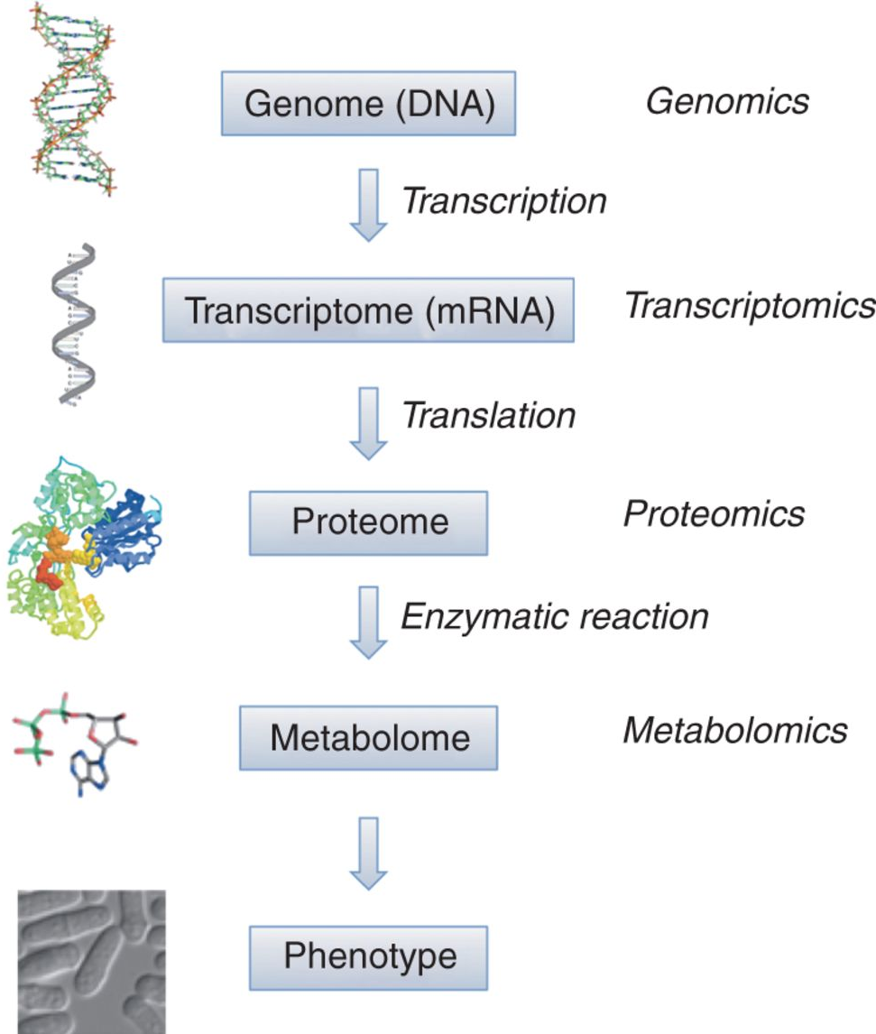
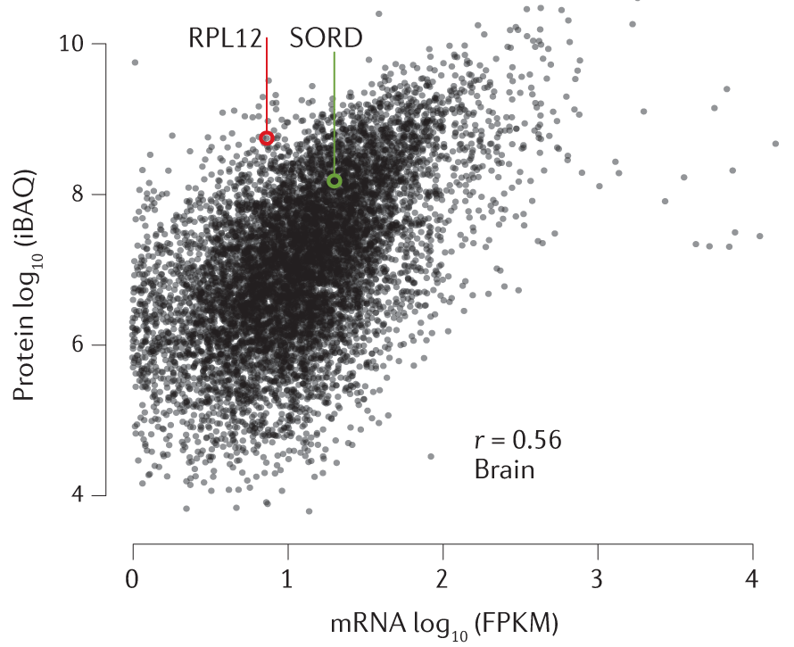
Central dogma and omics
doi:10.1101/pdb.top079921
https://doi.org/10.1038/s41576-020-0258-4

Slide 6
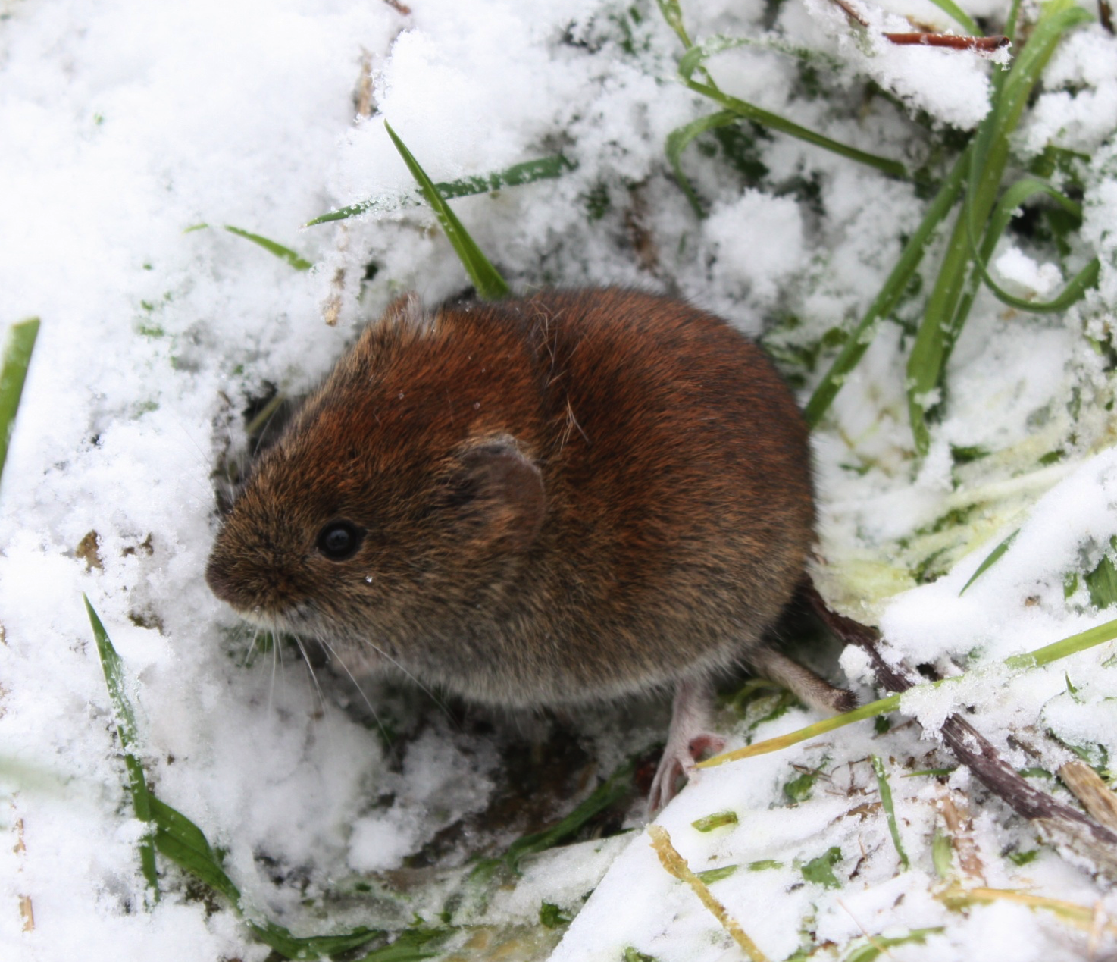
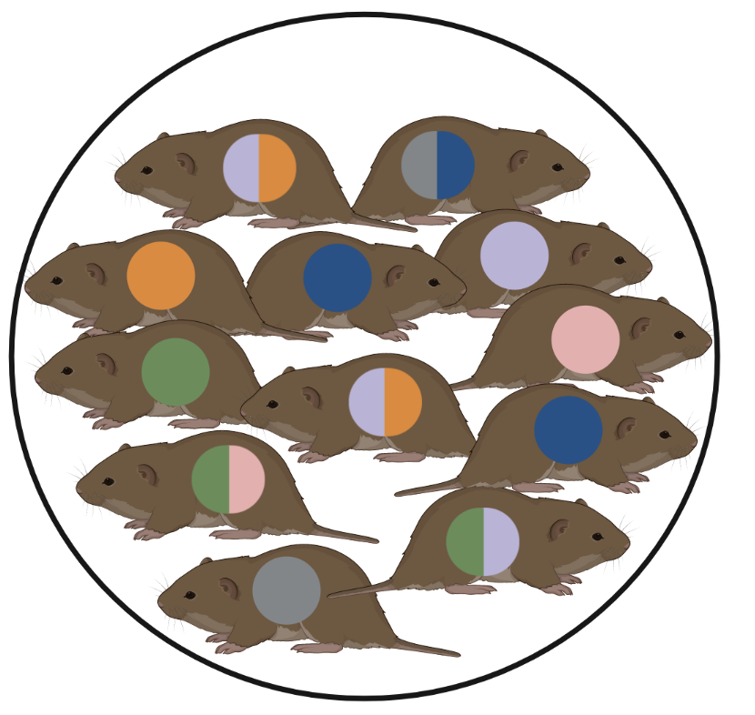
When is RNA sequencing useful?
How does genetic variation affect immune response to different infections?

Slide 7
When else is RNAseq useful?
Systemic changes in gene expression between two or more conditions
Unknown processes – identify which pathways contribute to differences in phenotype
Diseased vs healthy
Condition A vs condition B
Population A vs population B
…

Slide 8
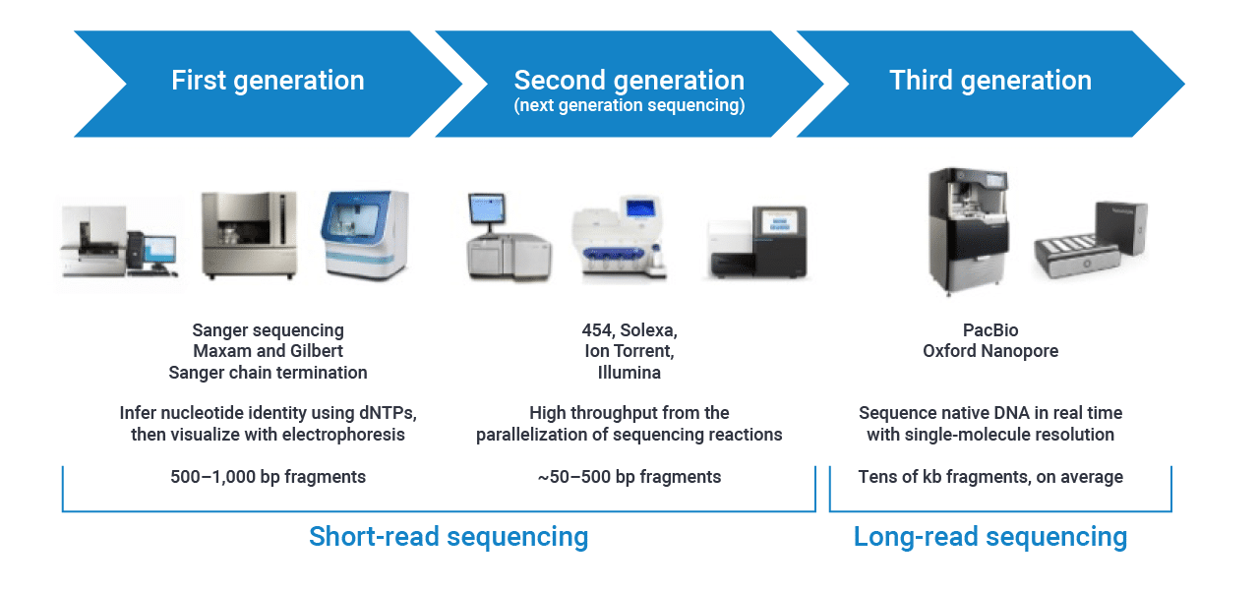
Sequencing platforms
https://www.pacb.com/blog/the-evolution-of-dna-sequencing-tools/

Slide 9
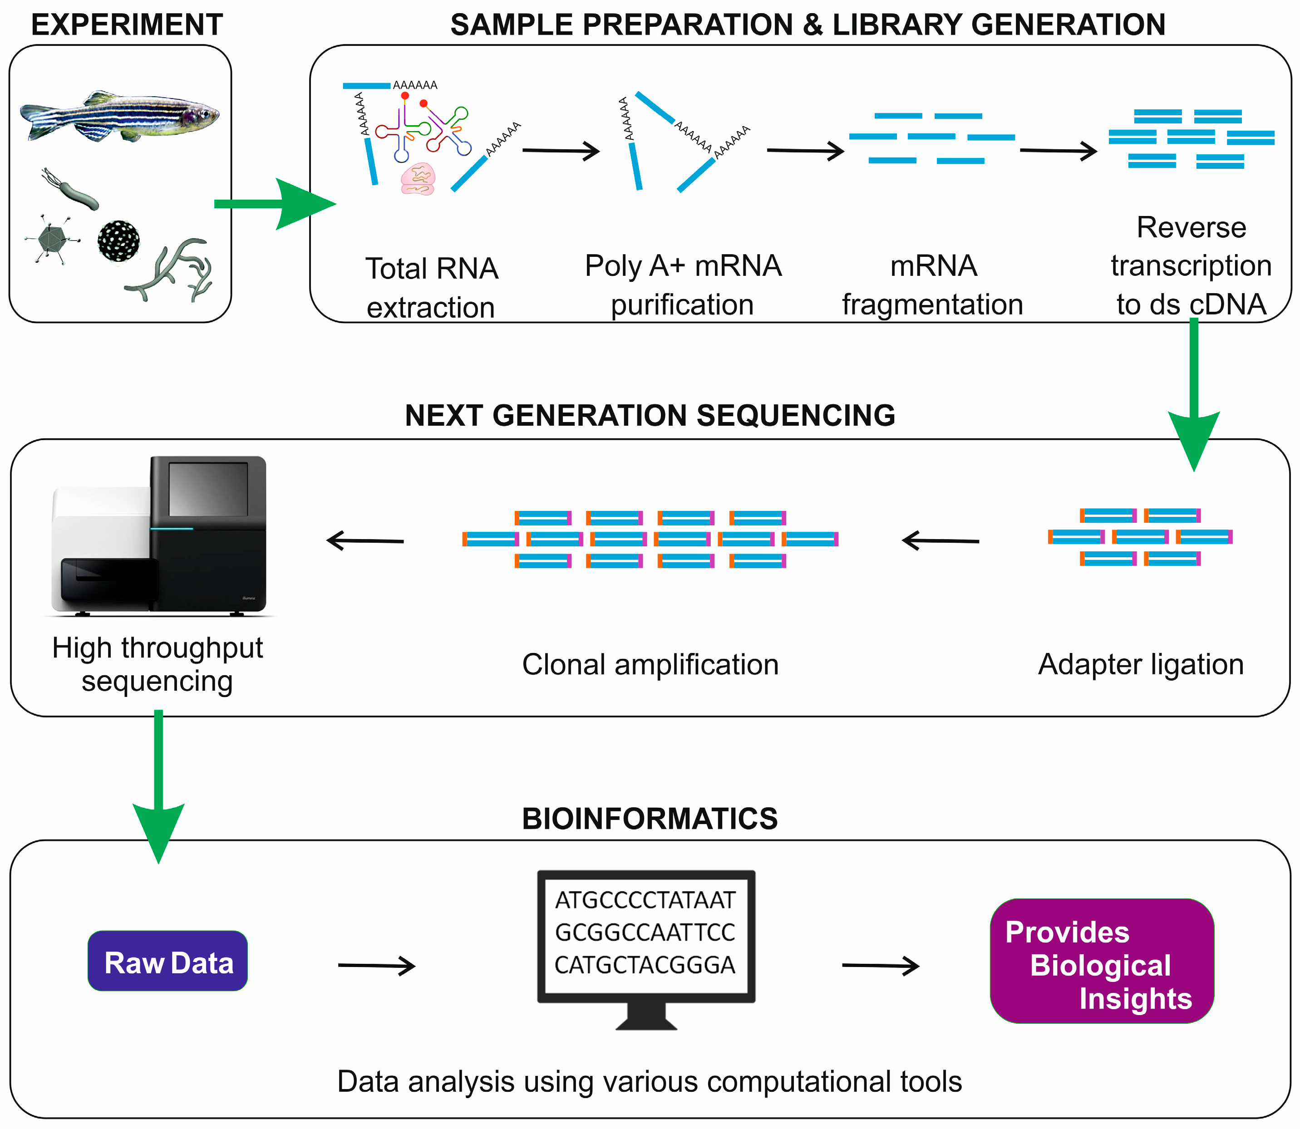
Typical workflow for RNA-sequencing
https://doi.org/10.3390/ijms19010245

Slide 10
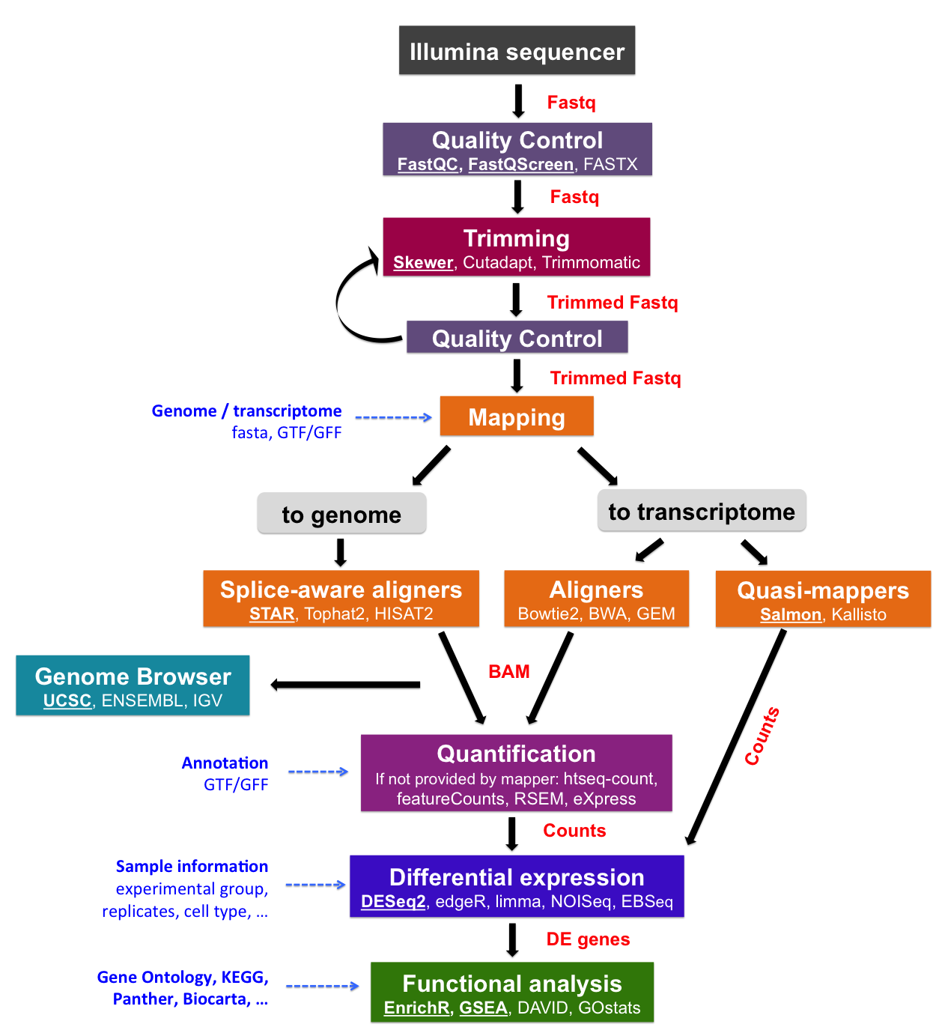
A standard pipeline for RNAseq analysis
https://biocorecrg.github.io/PHINDaccess_RNAseq_2020/alignment.html

Slide 11
Considerations for reference: genome or transcriptome?
Map against genome if:
There is a complete reference genome available
Interested in novel transcript discovery, variant calling
No constraints for hardware resources and time
If not above, map against a reference transcritpome

Slide 12
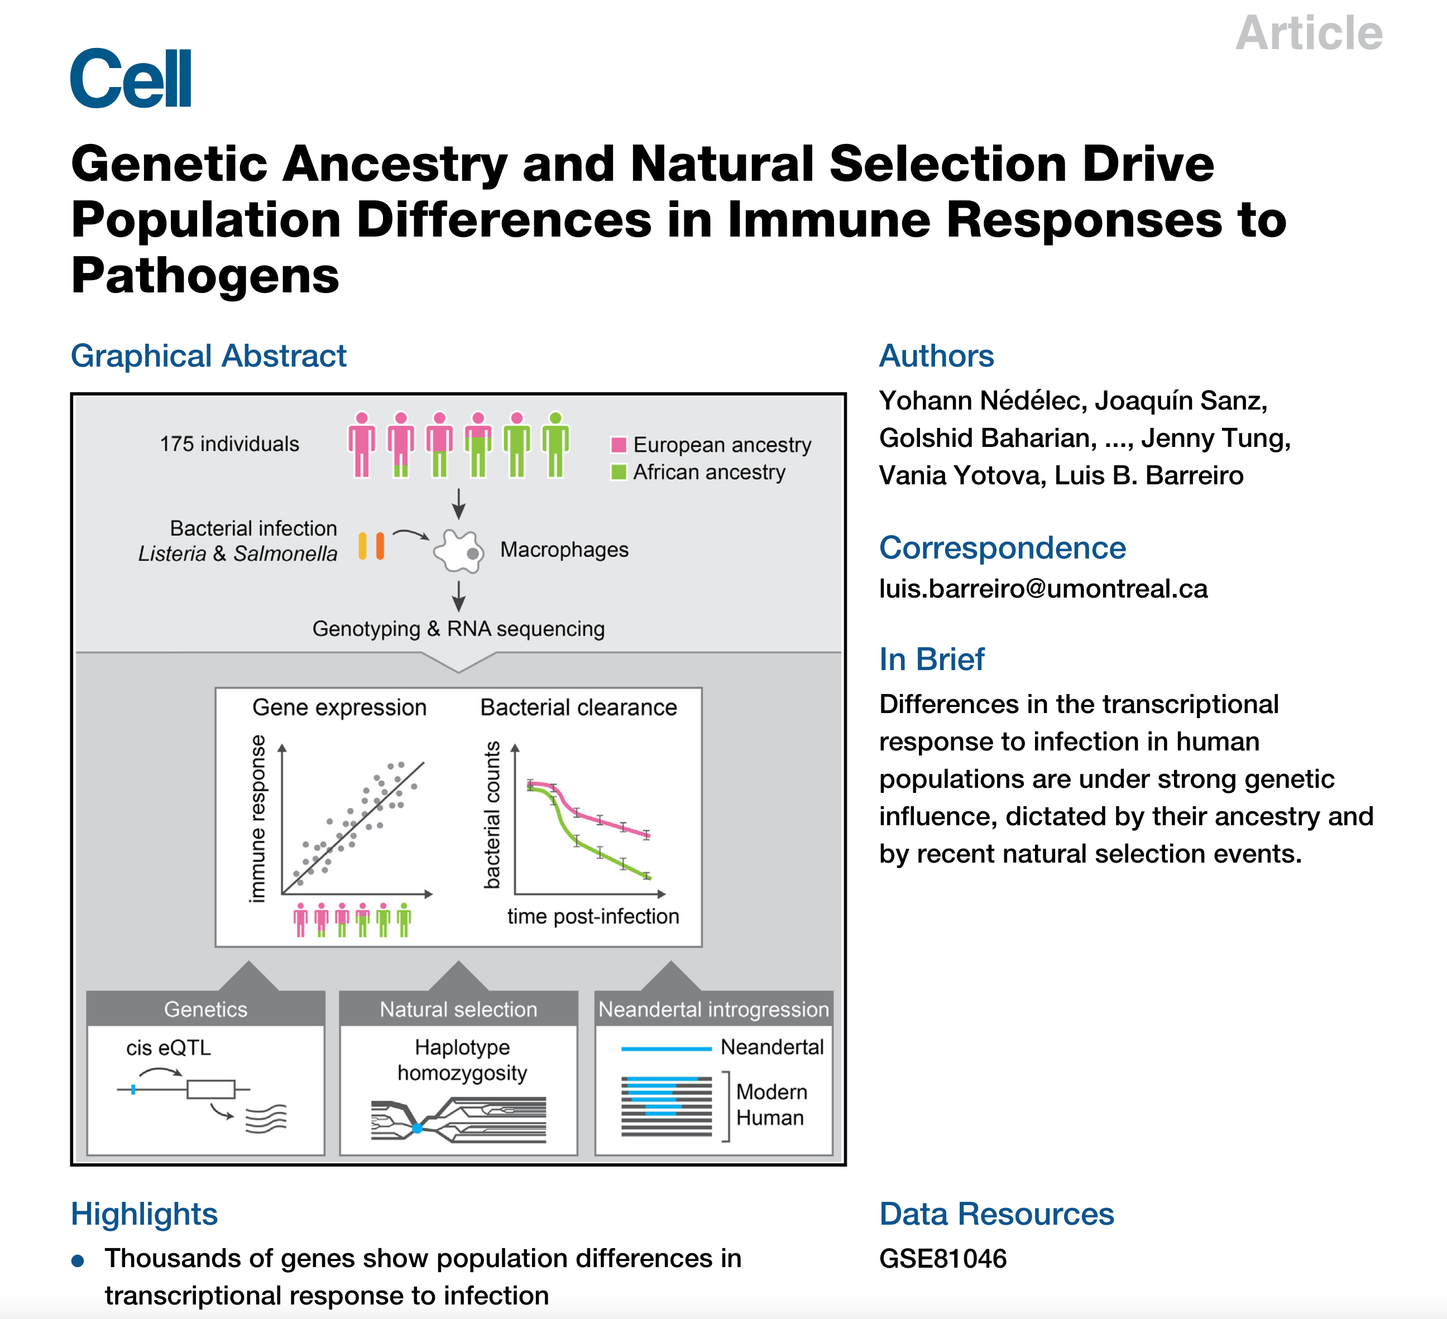
Accessing data
Most published work will be publically accessible for download
NGS deposited on NCBI’s Sequence Read Archive (https://www.ncbi.nlm.nih.gov/sra)
Project desgin and overview are docuemented on NCBI’s Gene Expression Omnibus
http://dx.doi.org/10.1016/j.cell.2016.09.025

Slide 13
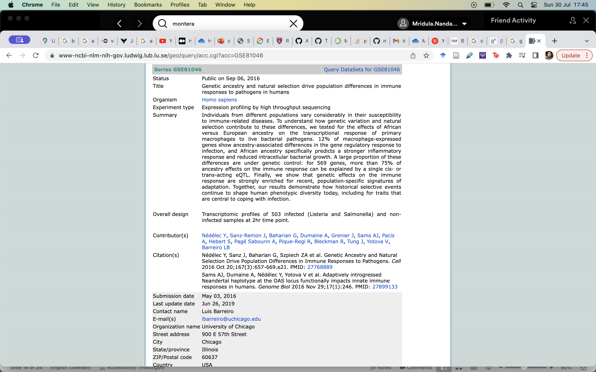
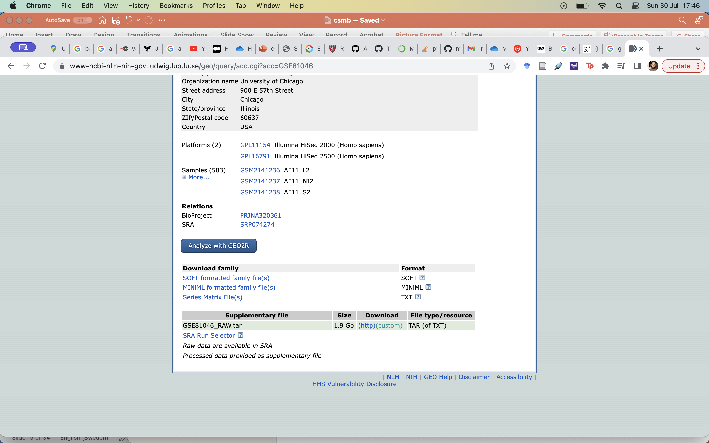

Slide 14
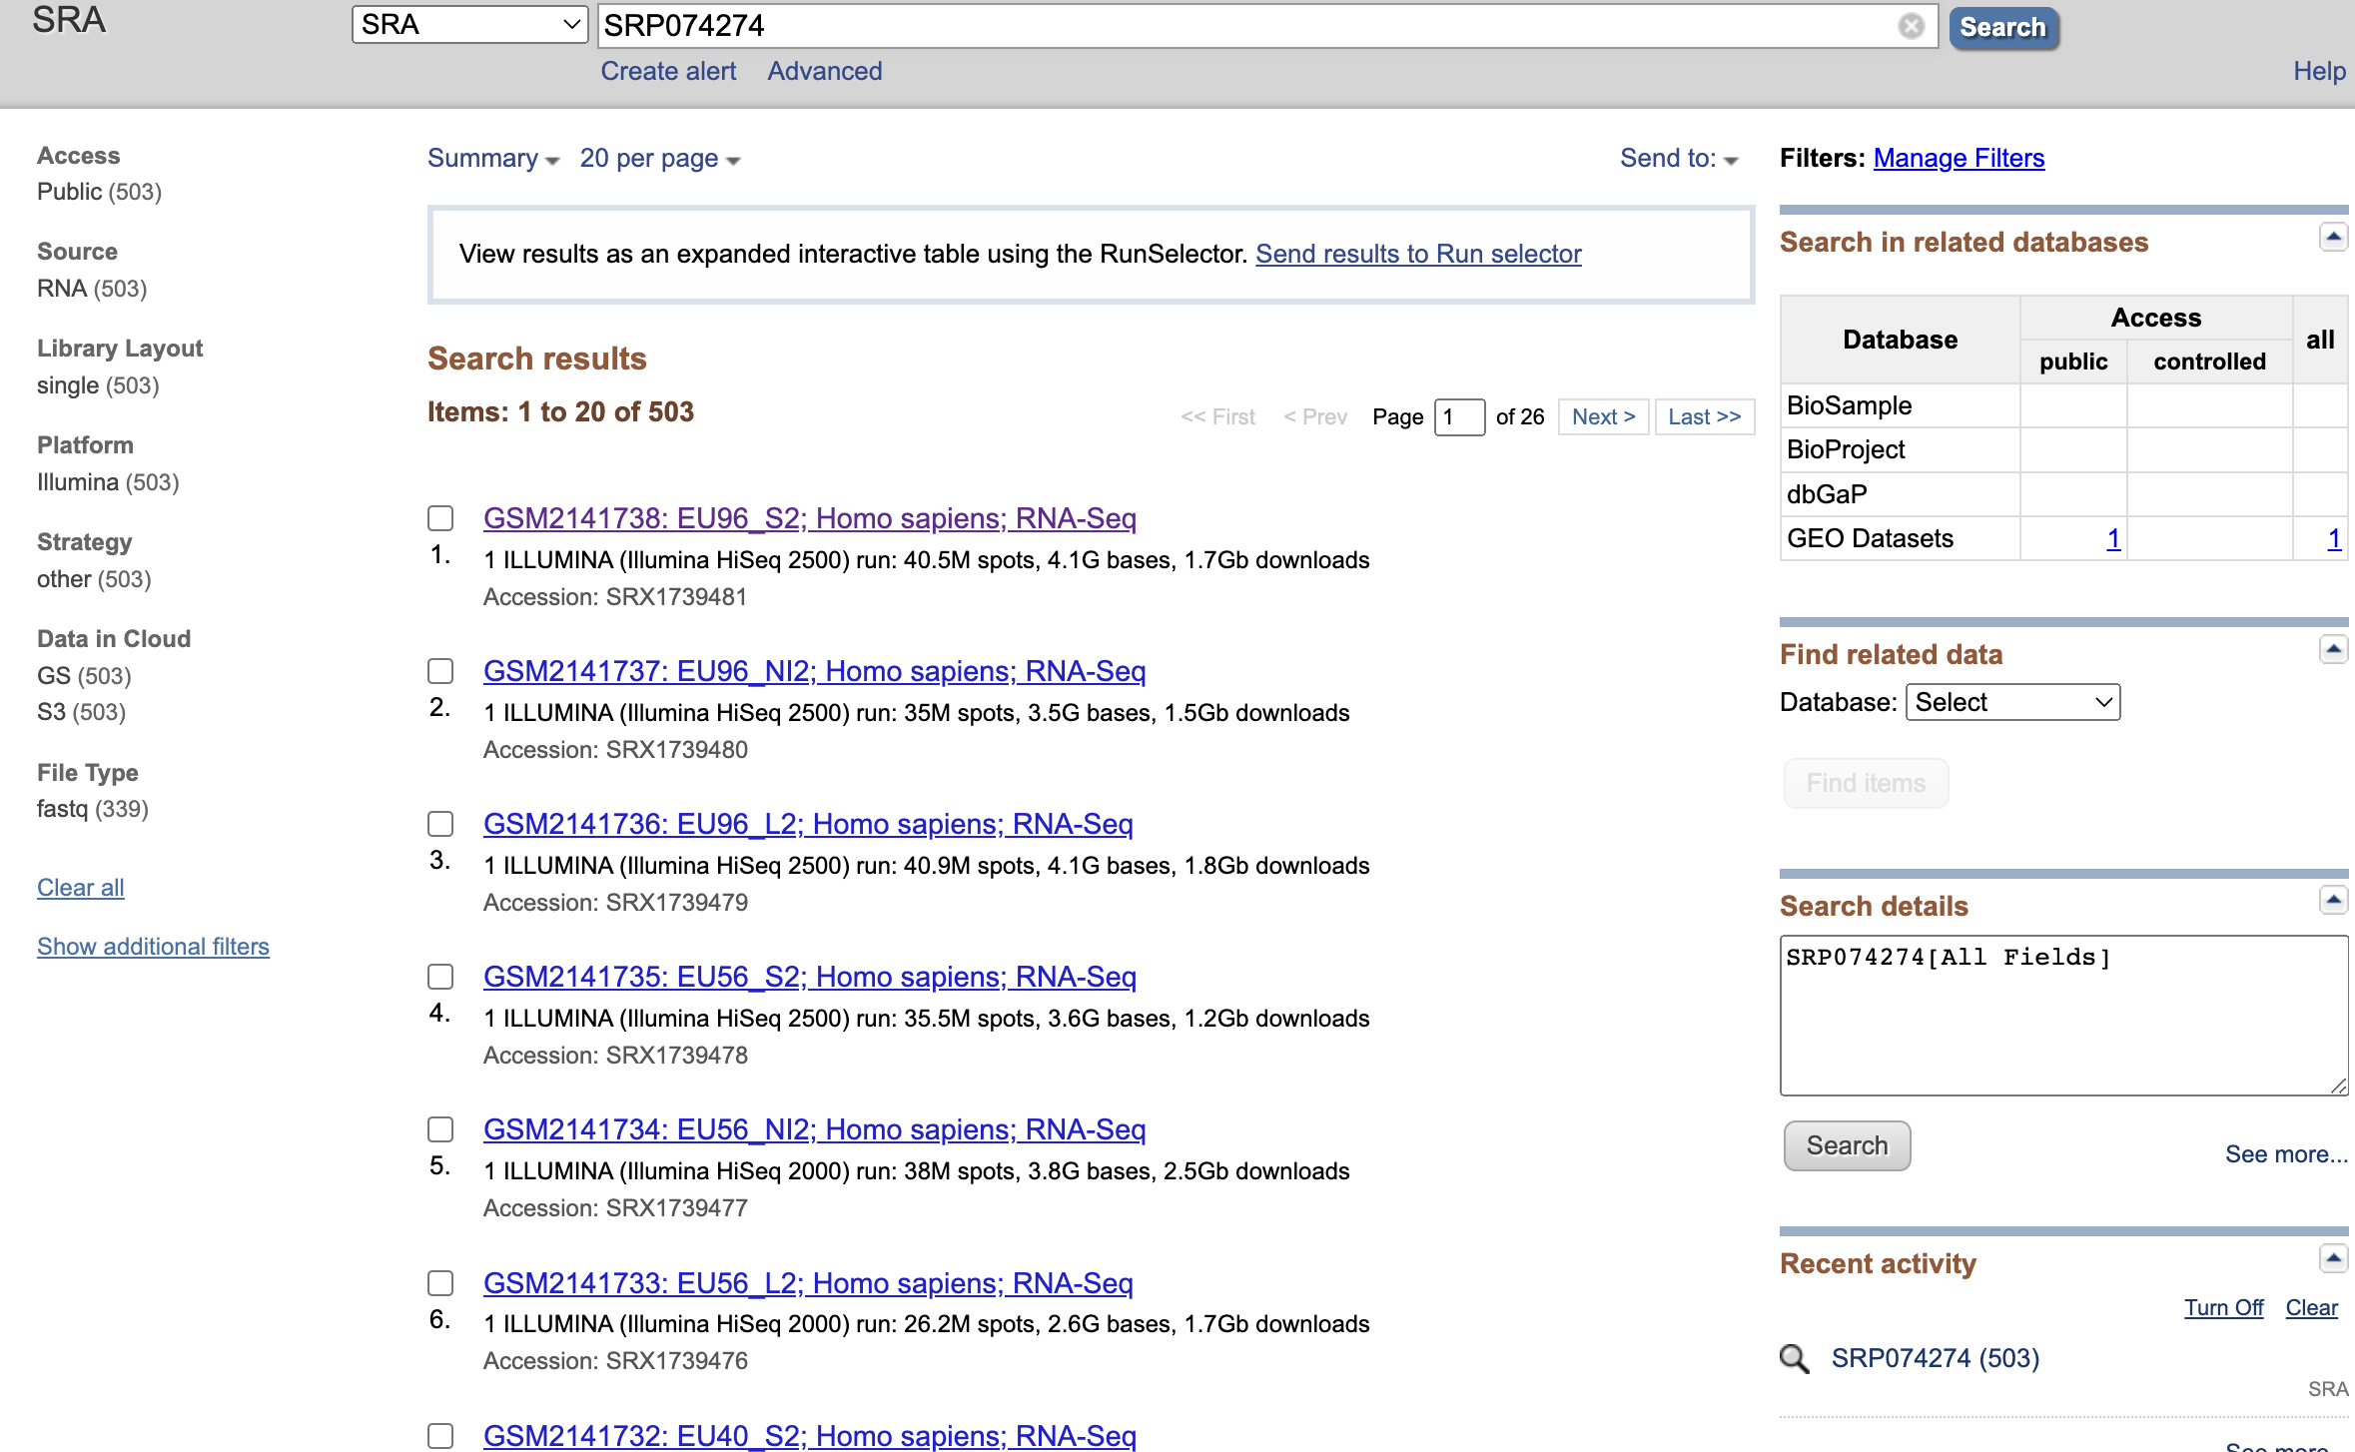
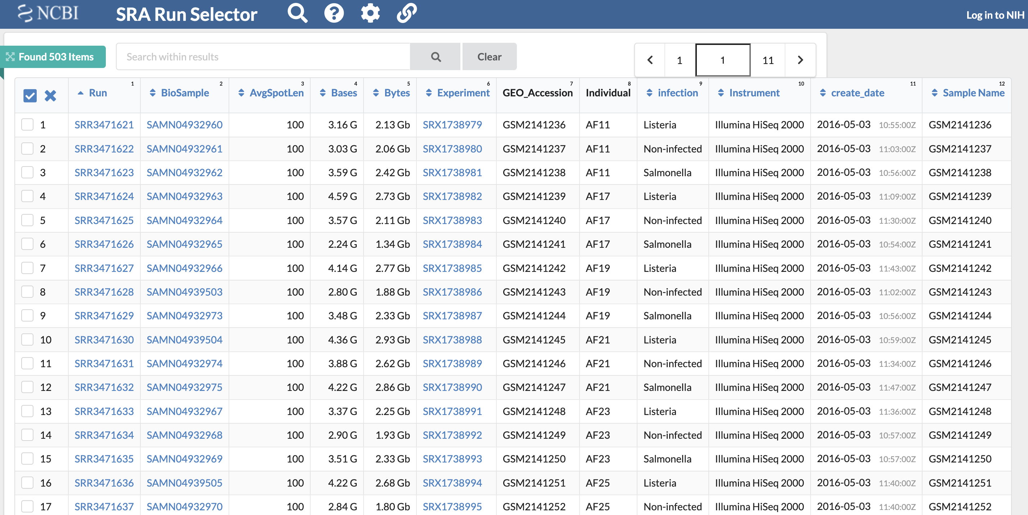

Slide 15
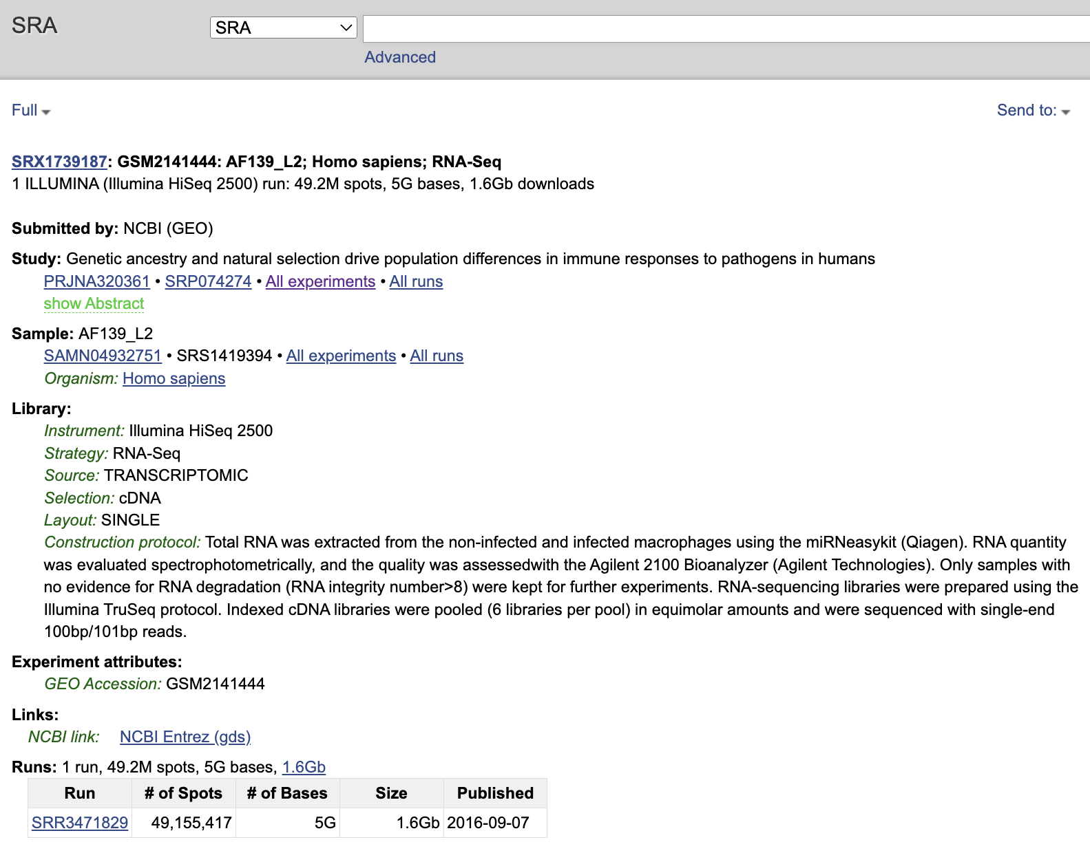
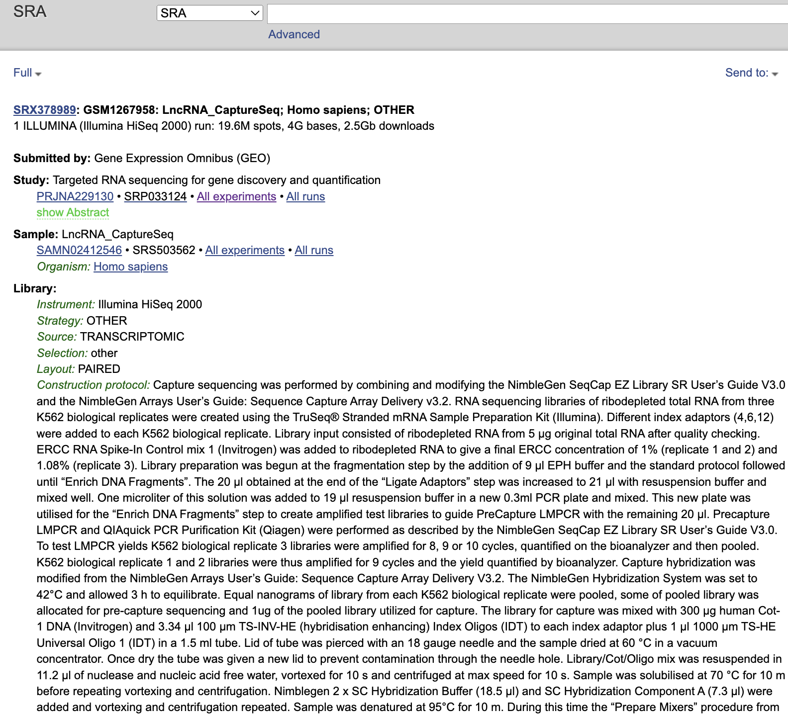

Slide 16
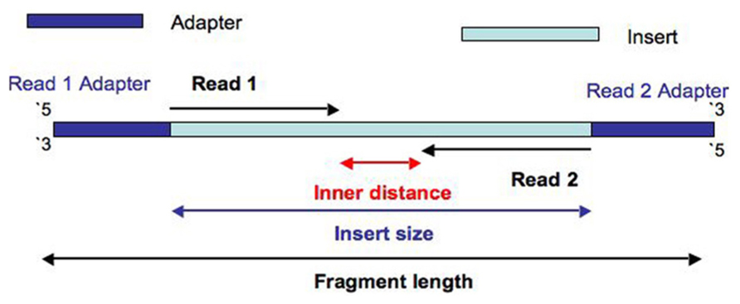
A typical raw read
https://doi.org/10.3389/fgene.2014.00005

Slide 17
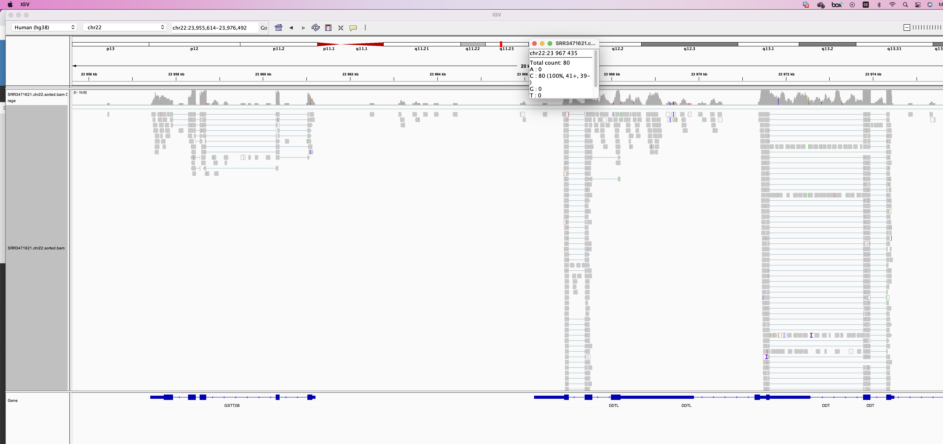
Mapping with standard aligners

Slide 18
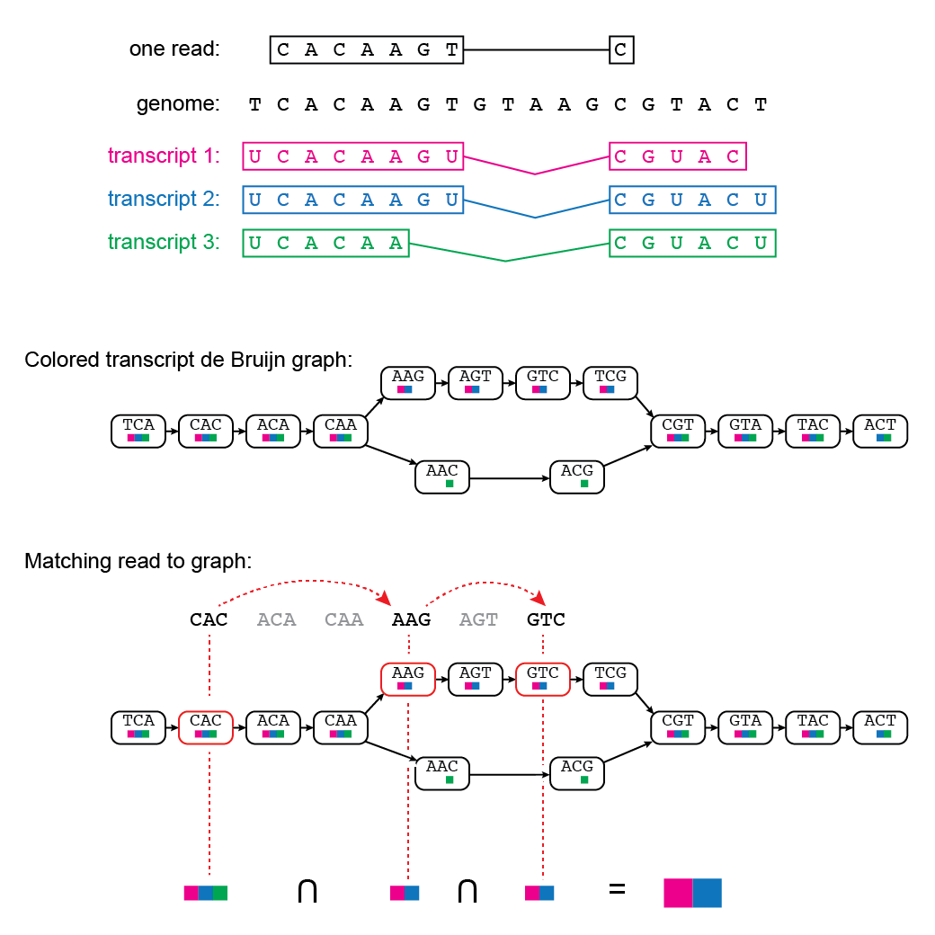
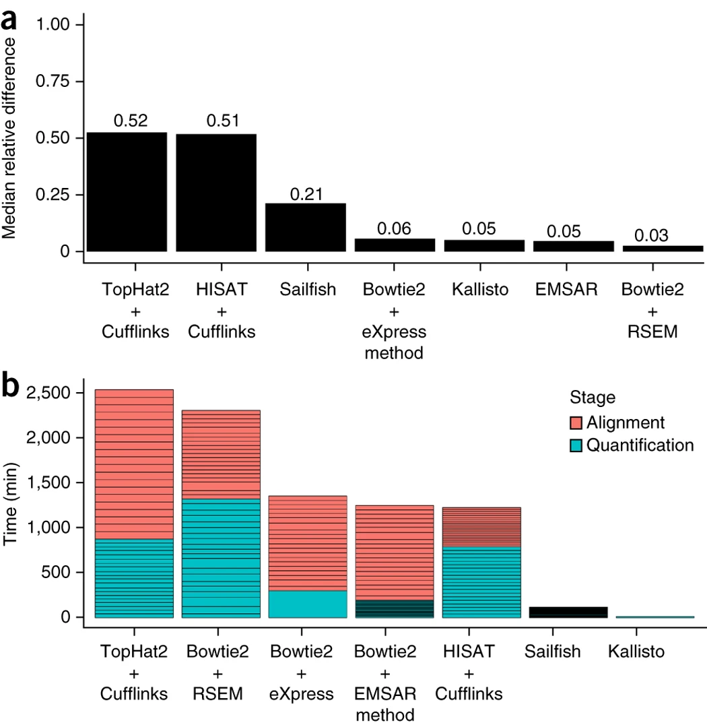
Pseudoalignment with kallisto
http://mcb112.org/w02/w02-lecture.html
doi:10.1038/nbt.3519

Slide 19
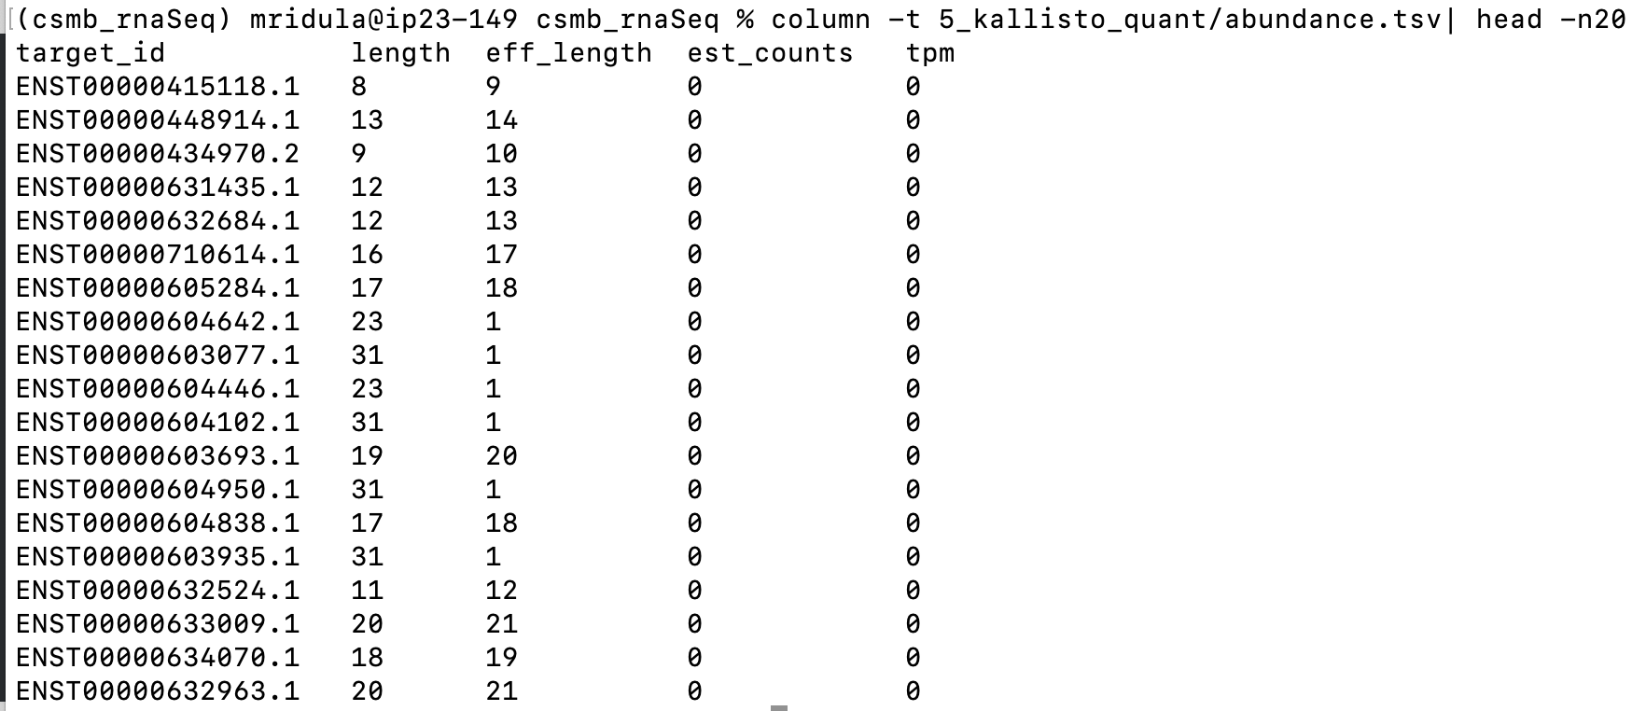
Abundance file

Slide 20
Outline for today
Setting up: special attention to Windows users
Download necessary data
Trim adapter sequences with cutadapt
Quality check with FastQC
Index reference transcriptome with kallisto
Pseudoalign reads with kallisto
To keep in mind:
What am I doing in this step?
Why am I doing it?
What is my input and what is my output?
What parameters are being used?

Slide 21
Time to begin!
https://github.com/mridna/csmb2023_RNASeq

Slide 22
Recap
Understand the advantage of RNA sequencing
Basic workflow for a RNAseq project
Pipelines in RNA sequencing
How Kallisto operates differently than other aligners
Execute a pipeline for RNAseq analysis

